Slide 1
Artificial Intelligence First Order Predicate Logic
unknown
RL
known
deterministic
stochastic
atomic
SEARCH
MDPs
factored
LOGIC
Bayes nets
structured
First-order logic

Slide 2
Outline
Limitation of Propositional Logic
Introduction to First Order Logic (FOL)
Knowledge Representation in FOL
Syntax
Semantics
Logical inference in FOL
Inference Rule
Resolution
Forward and Backward Chaining

Slide 3
Pros and Cons of Propositional Logic
Pros:
Propositional logic is declarative: pieces of syntax correspond to facts
Propositional logic allows partial/disjunctive/negated information (unlike most data structures and databases)
Propositional logic is compositional: meaning of B ∧ P is derived from meaning of B and of P
Meaning in propositional logic is context-independent (unlike natural language, where meaning depends on context)
Cons:
Propositional logic has very limited expressive power (unlike natural language)

Slide 4
Limitation of Propositional Logic
Propositional logic has limited expressive power.
We cannot represent relations like All, Some, or none with propositional logic. Example:
Statements about similar objects, relations
Statements referring to groups of objects
All the animals are intelligent.
Some apples are sweet.
We cannot describe statements in terms of their properties or logical relationships.

Slide 5
Limitation of Propositional Logic
Statements referring to groups of objects
Example:
Assume we want to express: “Every student likes vacation”
Require to include statements about every student
Rohit likes vacation ∧
Virat likes vacation ∧
Shubham likes vacation ∧ …..
Statements about objects and relations
Example:
Seniority of people domain
Virat is older than Rohit
Rohit is older than Shubham
To derive: Virat is older than Shubham
Virat is older than Rohit ∧ Rohit is older than Shubham ⇒ Virat is older than Shubham
Assume we add another fact:
Mahi is older than Rohit
To derive:
Mahi is older than Rohit ∧ Rohit is older than Shubham ⇒ Mahi is older than Shubham
Problem: KB grows large
Solution: ?
Possible solution:
Allow quantification in statements
Universal (∀) and Existential (∃)
Possible solution: introduce variables
A is older than B ∧ B is older than C ⇒ A is older than C
∀x student(x) ⇒ like_vacation(x)

Slide 6
First-Order Logic
Another way of knowledge representation in artificial intelligence.
FOL is sufficiently expressive to represent the natural language statements
Propositional logic: world contains facts
First-order logic: the world contains objects, relations, and functions
Objects: people, houses, numbers, theories, location, colors, baseball games, wars, centuries . . .
Relations: brother of, bigger than, inside, part of, has color, occurred after, owns, comes between, . . .
Functions: father of, best friend, third inning of, one more than, end of . . .
Introducing variables that refer to an arbitrary objects
Introducing quantifiers allowing us to make statements over groups objects

Slide 7
Logic
Logic is defined by:
A set of sentences
A sentence is constructed from a set of primitives according to syntax rules.
A set of interpretations
An interpretation gives a semantic to primitives. It associates primitives with objects, values in the real world.
The valuation (meaning) function V
Assigns a truth value to a given sentence under some interpretation
V : sentence × interpretation → {True , False }

Slide 8
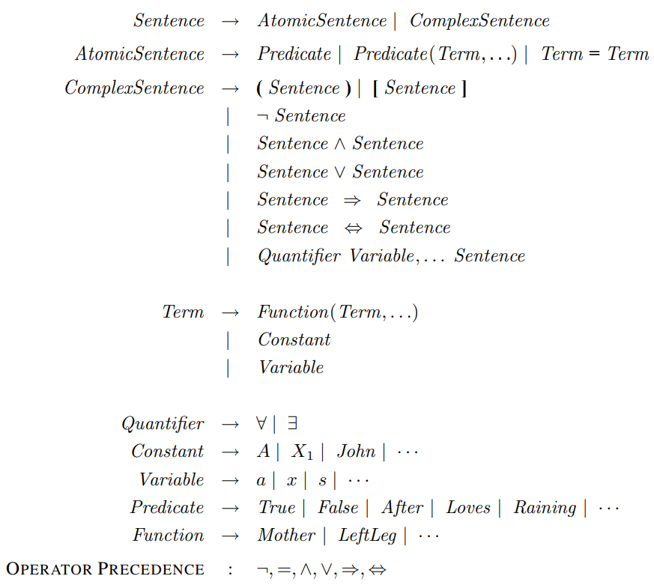
First Order Logic: Syntax
Term: syntactic entity for representing objects
Constant symbols: represent specific objects
Virat, India, Car
Variables: represent objects of a certain type
x, y, z
Functions: applied to one or more terms
father-of (Pratik), father-of(father-of(Pratik))

Slide 9
First Order Logic: Syntax
Sentences in FOL:
Atomic sentences:
A predicate symbol applied to 0 or more terms
Examples:
Red(Rose)
Sister(Arati, Jyoti)
Manager(father-of(Ritesh)
t1 = t2 equivalence of terms
Example:
Chha. Shivaji Maharaj = father-of(Chha. Sambhaji Maharaj)

Slide 10
First Order Logic: Syntax
Sentences in FOL:
Complex sentences:
Assume P, Q are sentences in FOL. Then:
(P ∧ Q ), (P ∨ Q ), (P ⇒ Q ), (P ⇔ Q ), ¬ Q
and ∀x P ∃y Q are sentences
Symbols ∃, ∀
stand for the existential and the universal quantifier

Slide 11
First Order Logic: Syntax
All birds fly.
The predicate is "fly(bird).“
∀x bird(x) ⇒ fly(x)
Every man respects his parent.
The predicate is "respect(x, y)," where x=man, and y= parent.
∀x man(x) ⇒ respects(x, parent)
Some boys play cricket.
In this sentence, the predicate is "play(x, y)," where x= boys, and y= game.
∃x boys(x) ⇒ play(x, cricket)

Slide 12
Dealing with Quantifiers
∀ can be thought of as “conjunction” over all objects in domain:
e.g.,
can be interpreted as
∃ can be thought of as “disjunction” over all objects in domain:
e.g.,
can be interpreted as
Quantifier Duality
Each can be expressed using the other
This is an application of DeMorgan’s laws
examples:

Slide 13
Dealing with Quantifiers
Usually use ⇒ with ∀:
e.g., says, all humans are mortal
but, say, everything is human and mortal
Usually use ∧ with ∃:
e.g., says, there is a bird that does not fly
but, is also true for anything that is not a bird
∀x∃y is not the same as ∃y∀x :
e.g., says, there is someone who loves everyone
but, says, everyone is loved by at least one person

Slide 14






Semantic: Interpretation
An interpretation I is defined by a mapping to the domain of discourse D or relations on D
Domain of discourse: a set of objects in the world we represent and refer to;
An interpretation I maps:
Constant symbols to objects in D
I(Sachin) =
Predicate symbols to relations, properties on D
I(brother) = { ( , ); ( , ); ……. }
Function symbols to functional relations on D
I(father-of) = {( → ); {( → ); ……….}

Slide 15
Semantics of Sentences
Meaning (evaluation) function:
V : sentence × interpretation → {True , False}
A predicate: predicate(term-1, term-2, term-3, term-n) is true for the interpretation I , iff the objects referred to by term-1, term-2, term-3, term-n are in the relation referred to by predicate
I(Rohit) = I(Kunal) =
I(brother) = { ( , ); ( , ); ……. }
brother(Rohit, Kunal) = ( , ) in I(brother)
V(brother(Rohit, Kunal), I) = True

Slide 16
Semantics of Sentences with quantifiers
Universal quantification
V(∀x ∅, I) = True
Iff for all d ∈ D, V(∅, I[x/d]) = True
Existential quantification
V(∃x ∅, I) = True
Iff for all d ∈ D, s.t. V(∅, I[x/d]) = True
substitution of x with d

Slide 17
Semantics of Sentences with quantifiers
Universal quantification
All COEP students are smart
Assume the universe of discourse of x are COEP students
∀x at(x, COEP) ⇒ smart(x)
Assume the universe of discourse of x are students
∀x smart(x)
Assume the universe of discourse of x are people
∀x student(x) ∧ at(x, COEP) ⇒ smart(x)
Existential quantification
Someone at COEP is smart
Assume the universe of discourse of x are COEP affiliates
∃x smart(x)
Assume the universe of discourse of x are people
∃x at(x, COEP) ∧ student(x)

Slide 18
Semantics of Sentences with quantifiers
Assume two predicates S(x) and P(x)
Universal quantification
Typically, the ∀ connects with implication
All S(x) is P(x)
∀x ( S(x) ⇒ P(x) )
No S(x) is P(x)
∀x ( S(x) ⇒ ¬P(x) )
Existential quantification
Typically, the ∃ connects with a conjunction
Some S(x) is P(x)
∃x (S(x) ∧ P(x) )
Some S(x) is not P(x)
∃x (S(x) ∧ ¬P(x) )

Slide 19
Order of Quantifiers
Order of quantifiers of the same type does not matter
For all x and y, if x is a parent of y then y is a child of x
∀x,y parent(x, y) ⇒ child(y, x)
∀y,x parent (x, y) ⇒ child(y, x)
Order of different quantifiers changes the meaning
∀x∃y loves(x, y) : Everybody loves somebody
∃y∀x loves(x, y) : There is someone who is loved by everyone

Slide 20
Nested quantifiers
More than one quantifier may be necessary to capture the meaning of a statement in the predicate logic.
Example:
There is a person who loves everybody.
Translation:
Assume:
Variables x and y denote people
A predicate Loves(x, y) denotes: “x loves y”
Then we can write in the predicate logic: ∃x ∀y Loves(x, y)

Slide 21
Connection Between Quantifiers
Everyone likes ice cream
∀x likes(x, IceCream)
Is it possible to convey the same meaning using an existential quantifier ?
There is no one who does not like ice cream
¬∃x ¬likes(x, IceCream)
A universal quantifier in the sentence can be expressed using an existential quantifier !!!

Slide 22
Connection Between Quantifiers
Someone likes ice cream
∃x likes(x, IceCream)
Is it possible to convey the same meaning using an Universal quantifier ?
Not everyone does not like ice cream
¬∀x ¬likes(x, IceCream)
A existential quantifier in the sentence can be expressed using an universal quantifier !!!

Slide 23
Nested quantifiers
More than one quantifier may be necessary to capture the meaning of a statement in the predicate logic.
Order of quantifiers of the same type does not matter
For all x and y, if x is a parent of y then y is a child of x
∀x,y parent(x, y) ⇒ child(y, x)
∀y,x parent (x, y) ⇒ child(y, x)
Order of different quantifiers changes the meaning
∀x∃y loves(x, y) : Everybody loves somebody
∃y∀x loves(x, y) : There is someone who is loved by everyone

Slide 24
Examples
Suppose:
Variables x, y denote people
Loves(x, y) denotes “x loves y”
Translate:
Everybody loves Virat.
Everybody loves somebody.
There is somebody whom everybody loves.
There is somebody who Virat doesn't love.
There is somebody whom no one loves.
∀x Loves(x, Virat)
∀x ∃y Loves(x, y)
∃y ∀x Loves(x, y)
∃y ¬Loves(Virat, y)
∃y ∀x ¬Loves(x, y)

Slide 25
Some examples of FOL sentences
Every gardener likes the sun.
You can fool some of the people all of the time
You can fool all of the people some of the time.
No purple mushroom is poisonous.
∀x gardener(x) ⇒ likes (x, Sun)
∃x (person(x) ∧ ∀ t (time(t) ⇒ can-fool(x, t)))
∀x (person(x) ⇒ ∃ t (time(t) ∧ can-fool(x, t)))
¬∃x purple(x) ∧ mushroom(x) ∧ poisonous(x)
or, equivalently, ∀x (mushroom(x) ∧ purple(x)) ⇒ ¬poisonous(x)

Slide 26
Transformation to FOPC
Mary got good grades in courses CS101 and CS102
John passed CS102
Student who gets good grades in a course passes that course
Students who pass a course are happy
A student who is not happy hasn’t passed all his/her courses
Only one student failed all the courses

Slide 27
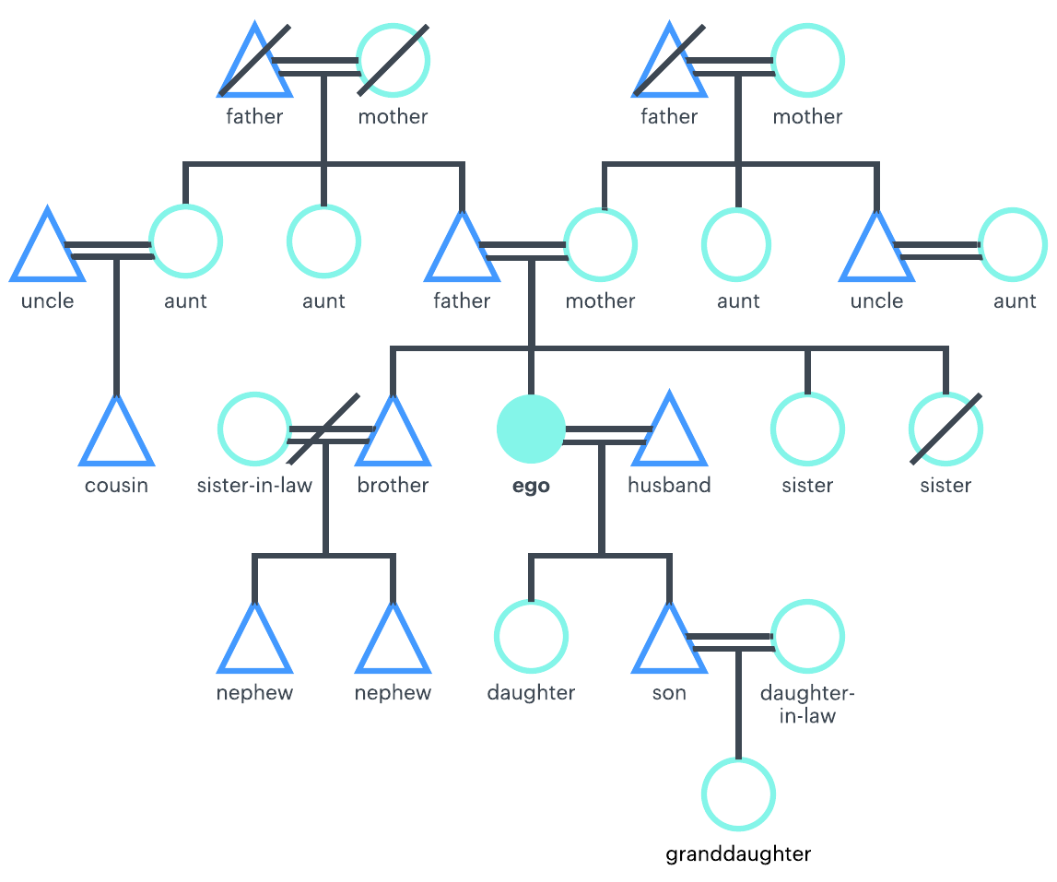
Representing knowledge in FOL
Example: Kinship domain
Objects: people
Jyoti, Arti, Dipak, …
Properties: gender
Male(x), Female(x)
Relations: parenthood, brotherhood, marriage
Parent ( x, y ), Brother ( x, y), Spouse ( x, y )
Functions: mother-of (one for each person x)
MotherOf (x)

Slide 28
Representing knowledge in FOL
Family
Spouse
Husband
Wife
Parent
Father
Mother
Step-father
Step-mother
Legal guardian
Child
Son
Daughter
Step-son
Step-daughter
Sibling
Brother
Sister
Extended family
Grandparent
Grandfather
Grandmother
Grandson
Granddaughter
Uncle
Aunt
Cousin
Nephew
Niece
Family-in-law
Father-in-law
Mother-in-law
Brother-in-law
Sister-in-law
Relation change
Marriage
Adoption
Relation end
Breakup
Divorced
Disownment
Emancipation
Widowhood

Slide 29
Knowledge engineering in FOL
Identify the problem/task you want to solve.
Assemble the relevant knowledge.
Decide on a vocabulary of predicates, functions, and constants.
Encode general knowledge about the domain.
Encode a description of the specific problem instance.
Pose queries to the inference procedure and get answers.
Debug the knowledge base.

Slide 30
Representing knowledge in FOL
Relations between predicates and functions: write down what we know about them; how relate to each other.
Male and female are disjoint categories
∀x Male ( x) ⇔ ¬Female ( x)
Parent and child relations are inverse
∀x, y Parent ( x, y ) ⇔ Child ( y, x)
A grandparent is a parent of parent
∀g, c Grandparent(g, c) ⇔ ∃p Parent(g, p) ∧ Parent( p, c)
A sibling is another child of one’s parents
∀x, y Sibling ( x, y) ⇔ ( x ≠ y) ∧ ∃p Parent ( p, x) ∧ Parent ( p, y)
And so on …

Slide 31
Inference in First order logic
Knowledge Representation

Slide 32
Logical inference in FOL
Logical inference problem:
Given a knowledge base KB (a set of sentences) and α (a sentence) , does the KB semantically entail α?
KB ╞ α ?
In other words: In all interpretations in which sentences in the KB are true, is also α true ?
Logical inference problem in the first-order logic is undecidable !!!.
No procedure that can decide the entailment for all possible input sentences in a finite number of steps.

Slide 33
Logical inference in FOL
Logical Inference in PL
KB ╞ α ?
Three approaches:
Truth-table approach
Inference rules
Resolution-refutation
Truth-table approach a viable for the FOL?
NO!
It would require us to enumerate and list all possible interpretations I
I = (assignments of symbols to objects, predicates to relations and functions to relational mappings)
Simply there are too many interpretations
Inference rule approach a viable for the FOL?
Yes.
The inference rules represent sound inference patterns one can apply to sentences in the KB
What is derived follows from the KB
Caveat: Need to add rules for handling quantifiers
Must involve variable substitutions

Slide 34



Theorem Proving: Inference Rule
(MP) Modes Ponens
(AI) And-Introduction
(OI) Or-Introduction
(AE) And-Elimination
(NE) Negation-Elimination
(UR) Unit Resolution
(R) General Resolution
Additional inference rules are needed
For sentences with quantifiers and variables
Must involve variable substitutions

Slide 35
Variable Substitutions
Variables in the sentences can be substituted with terms.
(terms = constants, variables, functions)
Substitution: Is a mapping from variables to terms
{x₁/t₁, x₂/t₂, …..}
Application of the substitution to sentences
SUBST({x/Ram, y/Sham}, Likes(x, y)) = Likes(Ram, Sham)
SUBST({ x/Ram , y/fatherof(Ram)}, Likes(x, y)) = Likes(Ram, fatherof(Ram))

Slide 36
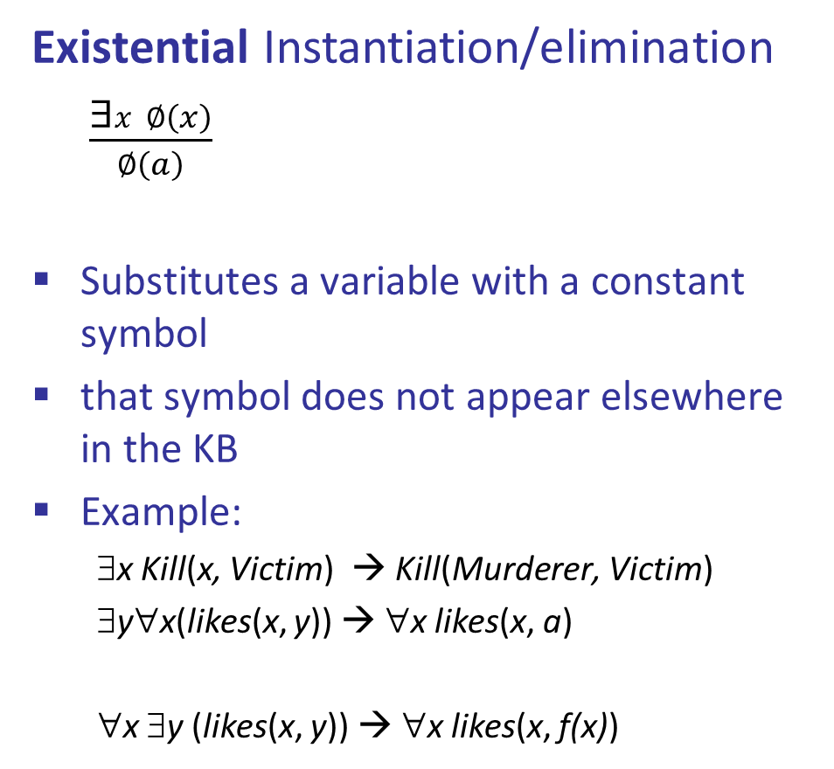
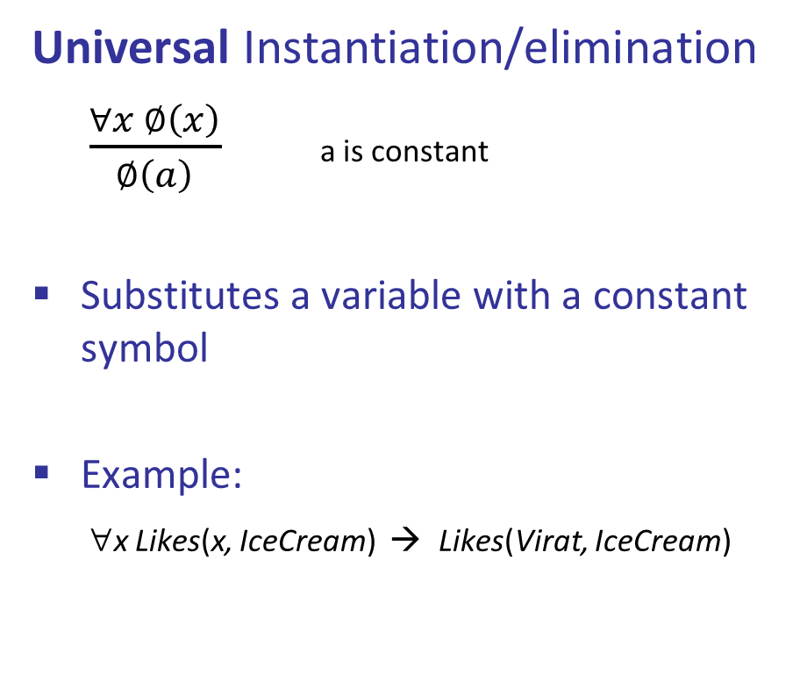
Inference Rules for Quantifiers
Universal Instantiation/elimination
$\frac{∀x ∅\left(x\right)}{∅\left(a\right)}$ a is constant
Substitutes a variable with a constant symbol
Example:
∀x Likes(x, IceCream) → Likes(Virat, IceCream)
Existential Instantiation/elimination
$\frac{\text{∃}x ∅\left(x\right)}{∅\left(a\right)}$
Substitutes a variable with a constant symbol
that symbol does not appear elsewhere in the KB
Example:
∃x Kill(x, Victim) → Kill(Murderer, Victim)
∃y∀x(likes(x, y)) → ∀x likes(x, a)
∀x ∃y (likes(x, y)) → ∀x likes(x, f(x))
Special constant called a Skolem constant
Special function called a Skolem function

Slide 37
Example of Derivation
Let KB = { parent(john ,mary), parent(john, joe),
KB╞
This derivation shows that KB╞

Slide 39
Reduction to Propositional Inference
Suppose the KB contains just the following:
∀x King(x) ∧ Greedy(x) ⇒ Evil(x)
King(John)
Greedy(John)
Brother(Richard, John)
Instantiating the universal sentence in all possible ways, we have:
King(John) ∧ Greedy(John) ⇒ Evil(John)
King(Richard) ∧ Greedy(Richard) ⇒ Evil(Richard)
King(John)
Greedy(John)
Brother(Richard, John)
The new KB is propositionalized: proposition symbols are
King(John), Greedy(John), Evil(John), King(Richard), etc.

Slide 40
Reduction to Propositional Inference
Every FOL KB can be propositionalized so as to preserve entailment
A ground sentence is entailed by new KB iff it is entailed by the original KB
Idea of the inference:
Propositionalize KB and query, apply resolution, return result
Problem:
With function symbols, there are infinitely many ground terms
E.g., Father(Father(Father(John)))
Theorem: Herbrand (1930)
If a sentence α is entailed by an FOL KB, it is entailed by a finite subset of the propositionalized KB
Idea: For n = 0 to ∞ do
Create a propositional KB by instantiating with depth-n terms
See if α is entailed by this KB
Problem: works if α is entailed, loops if α is not entailed

Slide 41
Problems with Propositionalization
Propositionalization seems to generate lots of irrelevant sentences
E.g., from:
∀x King(x) ∧ Greedy(x) ⇒ Evil(x)
King(John)
∀y Greedy(y)
Brother(Richard, John)
It seems obvious that Evil(John), but propositionalization produces lots of facts such as Greedy(Richard) that are irrelevant

Slide 42
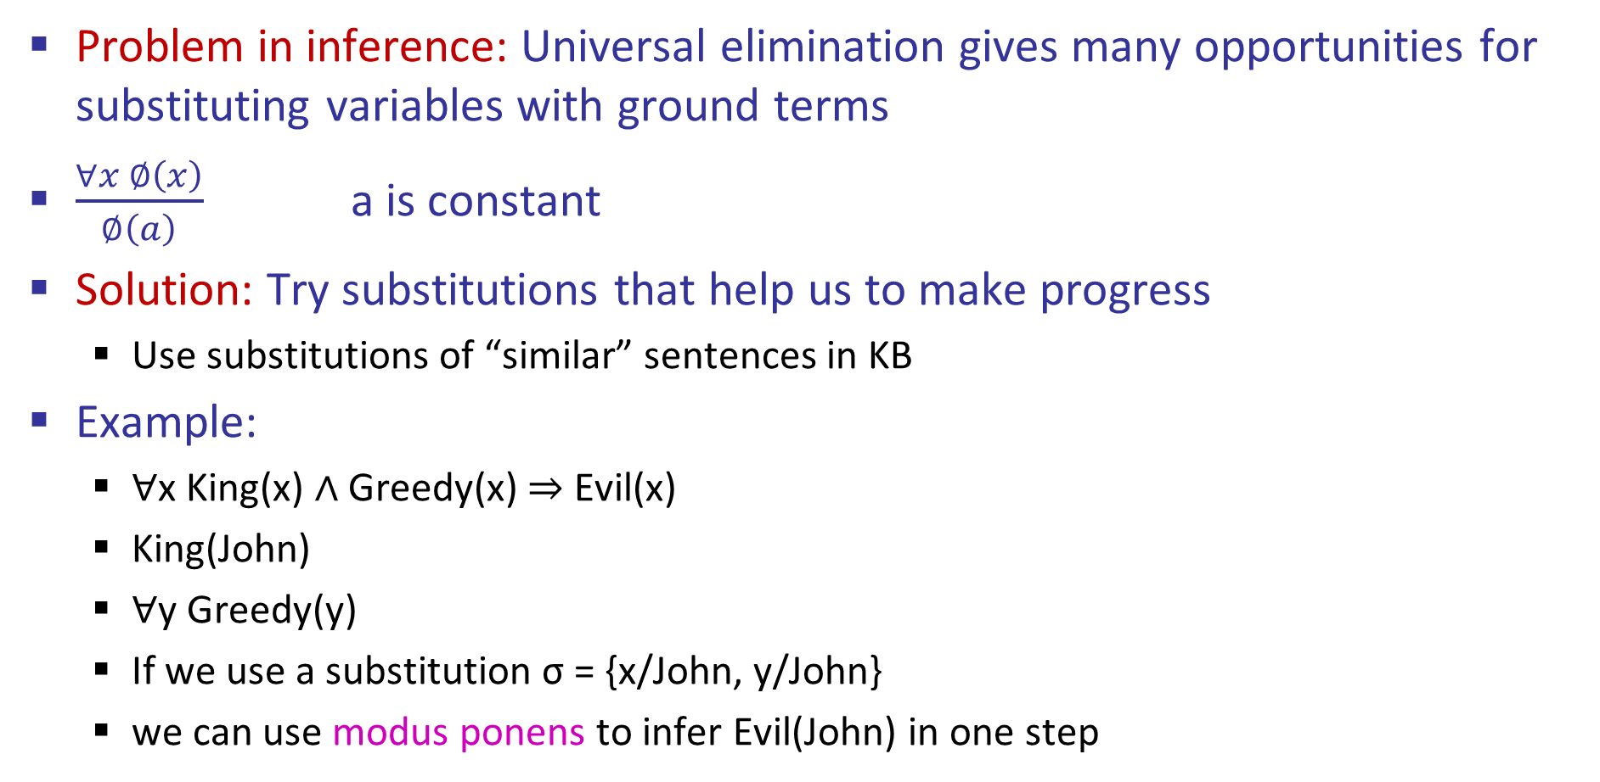
Unification (alignment)
Problem in inference: Universal elimination gives many opportunities for substituting variables with ground terms
$\frac{∀x ∅\left(x\right)}{∅\left(a\right)}$ a is constant
Solution: Try substitutions that help us to make progress
Use substitutions of “similar” sentences in KB
Example:
∀x King(x) ∧ Greedy(x) ⇒ Evil(x)
King(John)
∀y Greedy(y)
If we use a substitution σ = {x/John, y/John}
we can use modus ponens to infer Evil(John) in one step

Slide 43
Unification
Takes two similar sentences and computes the substitution that makes them look the same, if it exists
Use substitutions of “similar” sentences in KB
UNIFY ( p, q) = σ such that SUBST( σ, p) = SUBST (σ , q)
Examples:
UNIFY (Knows(John, x), Knows(John, Jane)) =
UNIFY(Knows(John, x),Knows(y, Ann)) =
UNIFY(Knows(John, x),Knows(y, Motherof(y))) =
UNIFY(Knows(John, x), Knows(x, Elizabeth)) =
{x/Jane}
{x/Ann, y/John}
{x/Motherof(John), y/John}
fail

Slide 44
Unification
To unify Knows(John,x) and Knows(y,z),
σ = {y/John, x/z } or σ = {y/John, x/John, z/John}
The first unifier is more general than the second.
There is a single most general unifier (MGU) that is unique up to renaming of variables.
MGU = { y/John, x/z }

Slide 45
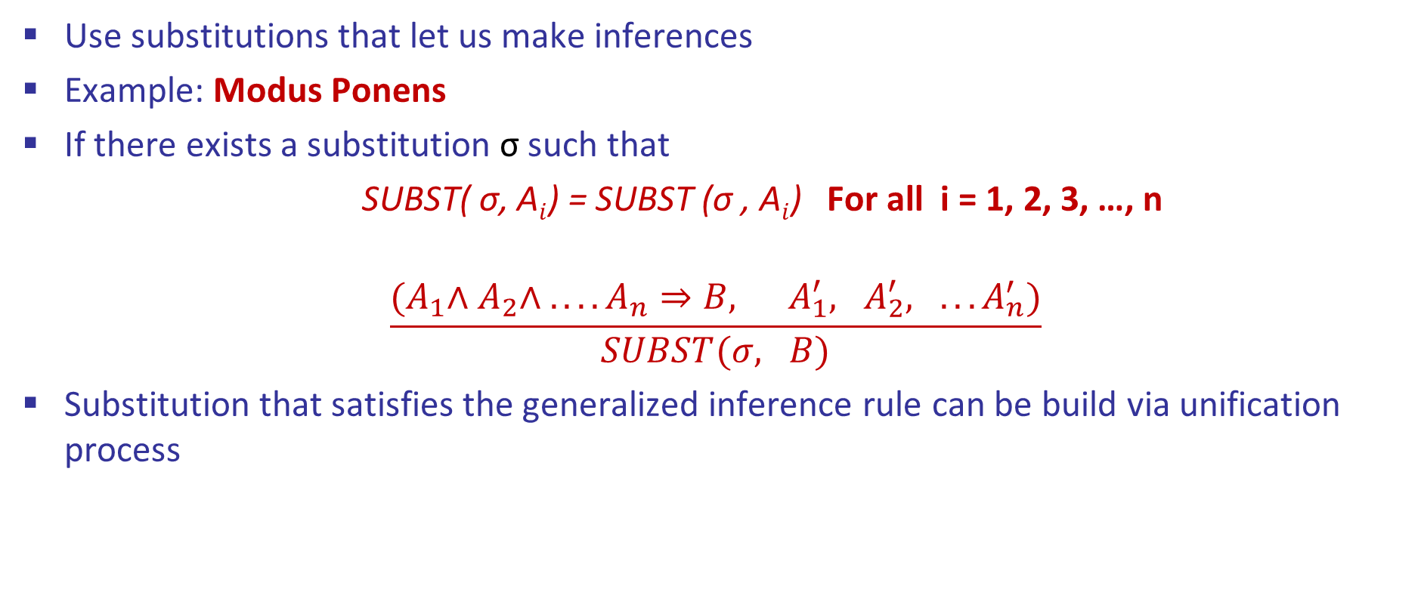
Generalized Inference Rules
Use substitutions that let us make inferences
Example: Modus Ponens
If there exists a substitution σ such that
SUBST( σ, A$i$) = SUBST (σ , A$i$) For all i = 1, 2, 3, …, n
$$\frac{{(A}_{1}∧{ A}_{2}∧ . . . . A_{n}⇒B, A_{1}^{′}, A_{2}^{′}, . . . A_{n}^{′})}{SUBST(σ, B)}$$
Substitution that satisfies the generalized inference rule can be build via unification process

Slide 46

Generalized Modus Ponens (GMP)
$$\frac{{(A}_{1}∧{ A}_{2}∧ . . . . A_{n}⇒B, A_{1}^{′}, A_{2}^{′}, . . . A_{n}^{′})}{SUBST(σ, B)}$$
Example:
∀x King(x) ∧ Greedy(x) ⇒ Evil(x)
King(John)
∀y Greedy(y)
Brother(Richard, John)
A1' is King(John) A1 is King(x)
A2' is Greedy(John) A2 is Greedy(John)
σ is {x/John, y/John} B is Evil(x)
SUBS(σ, B) = Evil(John)

Slide 47
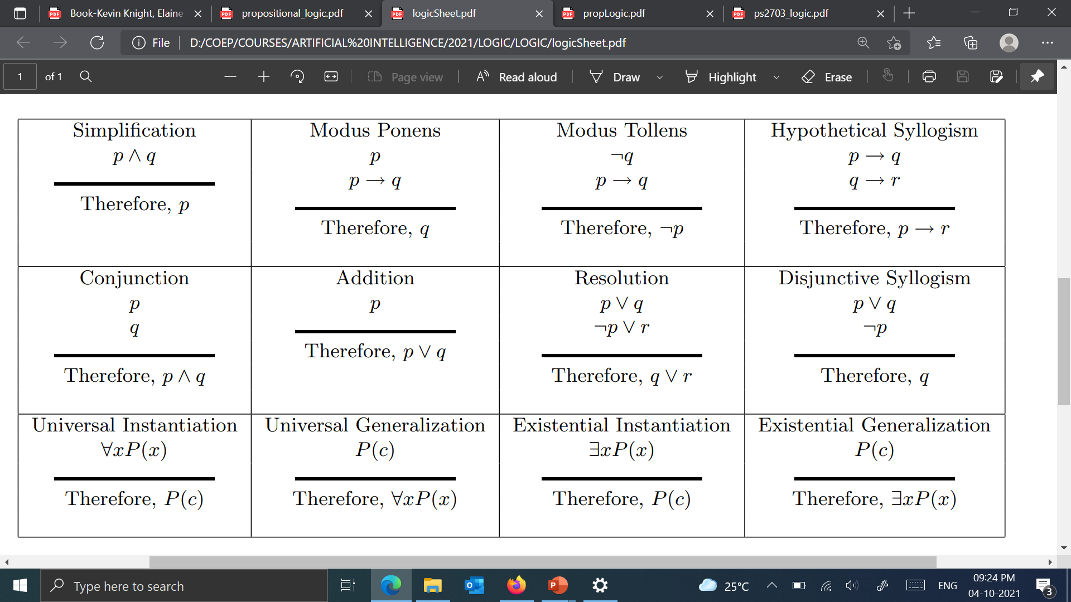
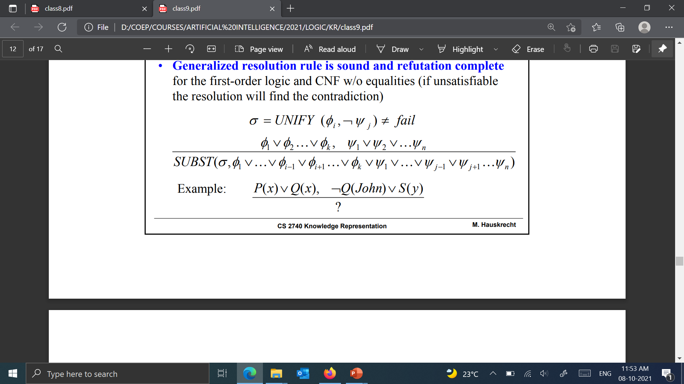
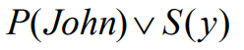
Resolution inference rule
Recall: Resolution inference rule is sound and complete (refutation-complete) for the propositional logic and CNF
Generalized resolution rule is sound and refutation complete for the first-order logic and CNF w/o equalities (if unsatisfiable the resolution will find the contradiction)
Example

Slide 48
Inference with Resolution Rule
Proof by refutation:
Prove that KB, ¬ α is unsatisfiable
Resolution is refutation-complete
Main procedure (steps):
Convert to CNF with ground terms and universal variables only
Apply repeatedly the resolution rule while keeping track and consistency of substitutions
Stop when empty set (contradiction) is derived or no more new resolvents (conclusions) follow

Slide 49
Resolution Rule of Inference
Resolution provides a complete rule of inference for first order predicate calculus
if used in conjunction with a refutation proof procedure (proof by contradiction)
requires that formulas be written in clausal form
Refutation procedure
to prove that KB ╞ α, show that KB ∧ ¬α is unsatisfiable
KB and ¬α, must be in CNF (conjunction of clauses)
Each step in the refutation procedure involves applying resolution to two clauses, in order to get a new clause
Inference continues until the empty clause {Ø} is derived (a contradiction)
C₁
C₂
C

Slide 50
Resolution Rule
Proof by refutation:
To prove that KB ╞ α, show that KB ∧ ¬α is unsatisfiable
KB and ¬α, must be in CNF (conjunction of clauses)
Resolution is refutation-complete
Refutation procedure
Each step in the refutation procedure involves applying resolution to two clauses, in order to get a new clause
Inference continues until the empty clause {Ø} is derived (a contradiction)
C₁
C₂
{Ø}

Slide 51
Recall the Refutation Procedure - Example
Given KB =
Prove KB╞ C
(clause 1)
(clause 3)
(clause 4)
(clause 2)
(clause 5)

Slide 52

Resolution Rule of Inference
Basic Propositional Version:
Full First-Order Version:
provided that p_{j} and ¬q_{k} are unifiable via a substitution σ
Example:
with substitution σ = {x/bob}
or equivalently

Slide 53
Resolution Example
KB = {¬P(w) ∨ Q(w)
¬Q(y) ∨ S (y)
P(x) ∨ R x)
¬R(z) ∨ S (z) }
α = S(A)

Slide 54
Resolution Example
KB ¬ α
¬P(w) ∨ Q(w) ¬Q(y) ∨ S (y) P(x) ∨ R x) ¬R(z) ∨ S (z), ¬S(A)
{y / w}
¬P(w) ∨ S (w)
{x / w}
S(w) ∨ R(w)
{z / w}
S (w)
{w / A}
{ }
KB ╞ α Contradiction

Slide 55
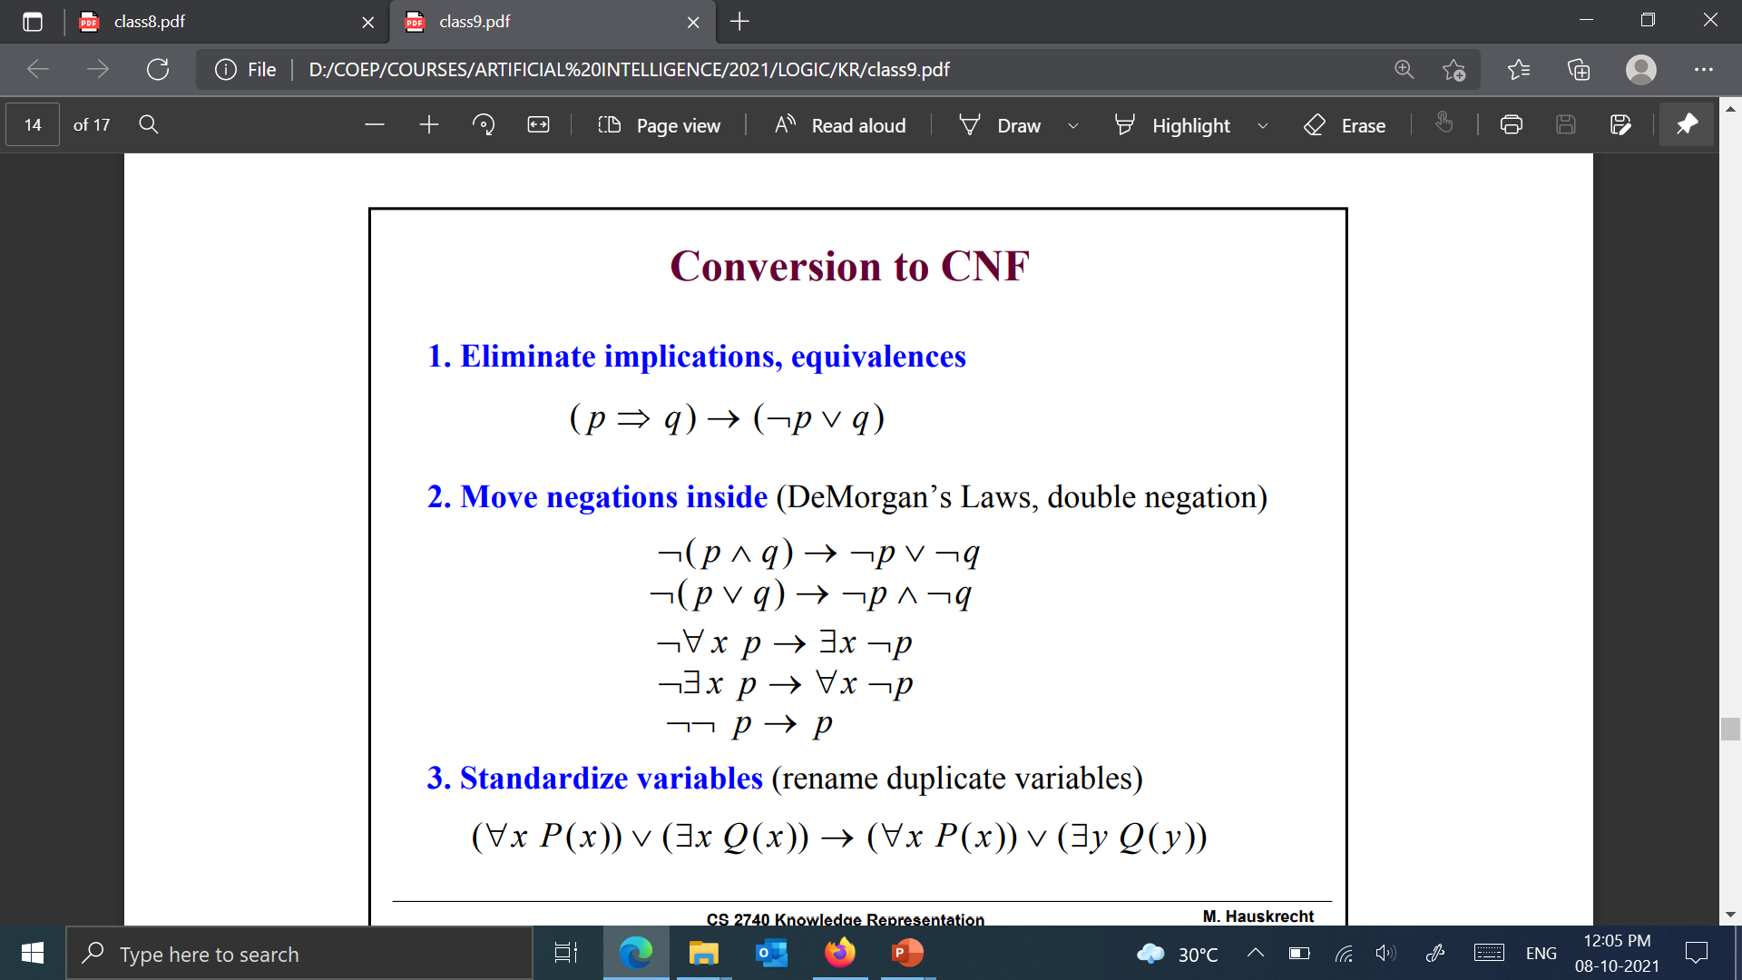
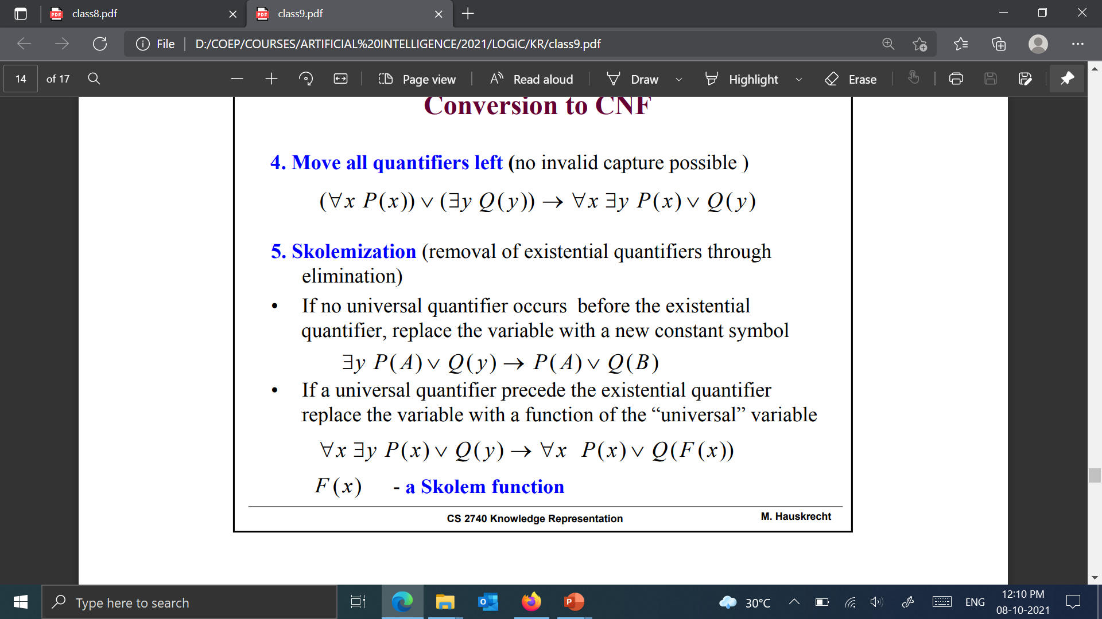
Conversion to CNF
Eliminate implications, equivalences
Move negations inside (DeMorgan’s Laws, double negation)
Standardise variables (Rename duplicate variables)
Move all quantifiers left (no invalid capture possible )

Slide 56
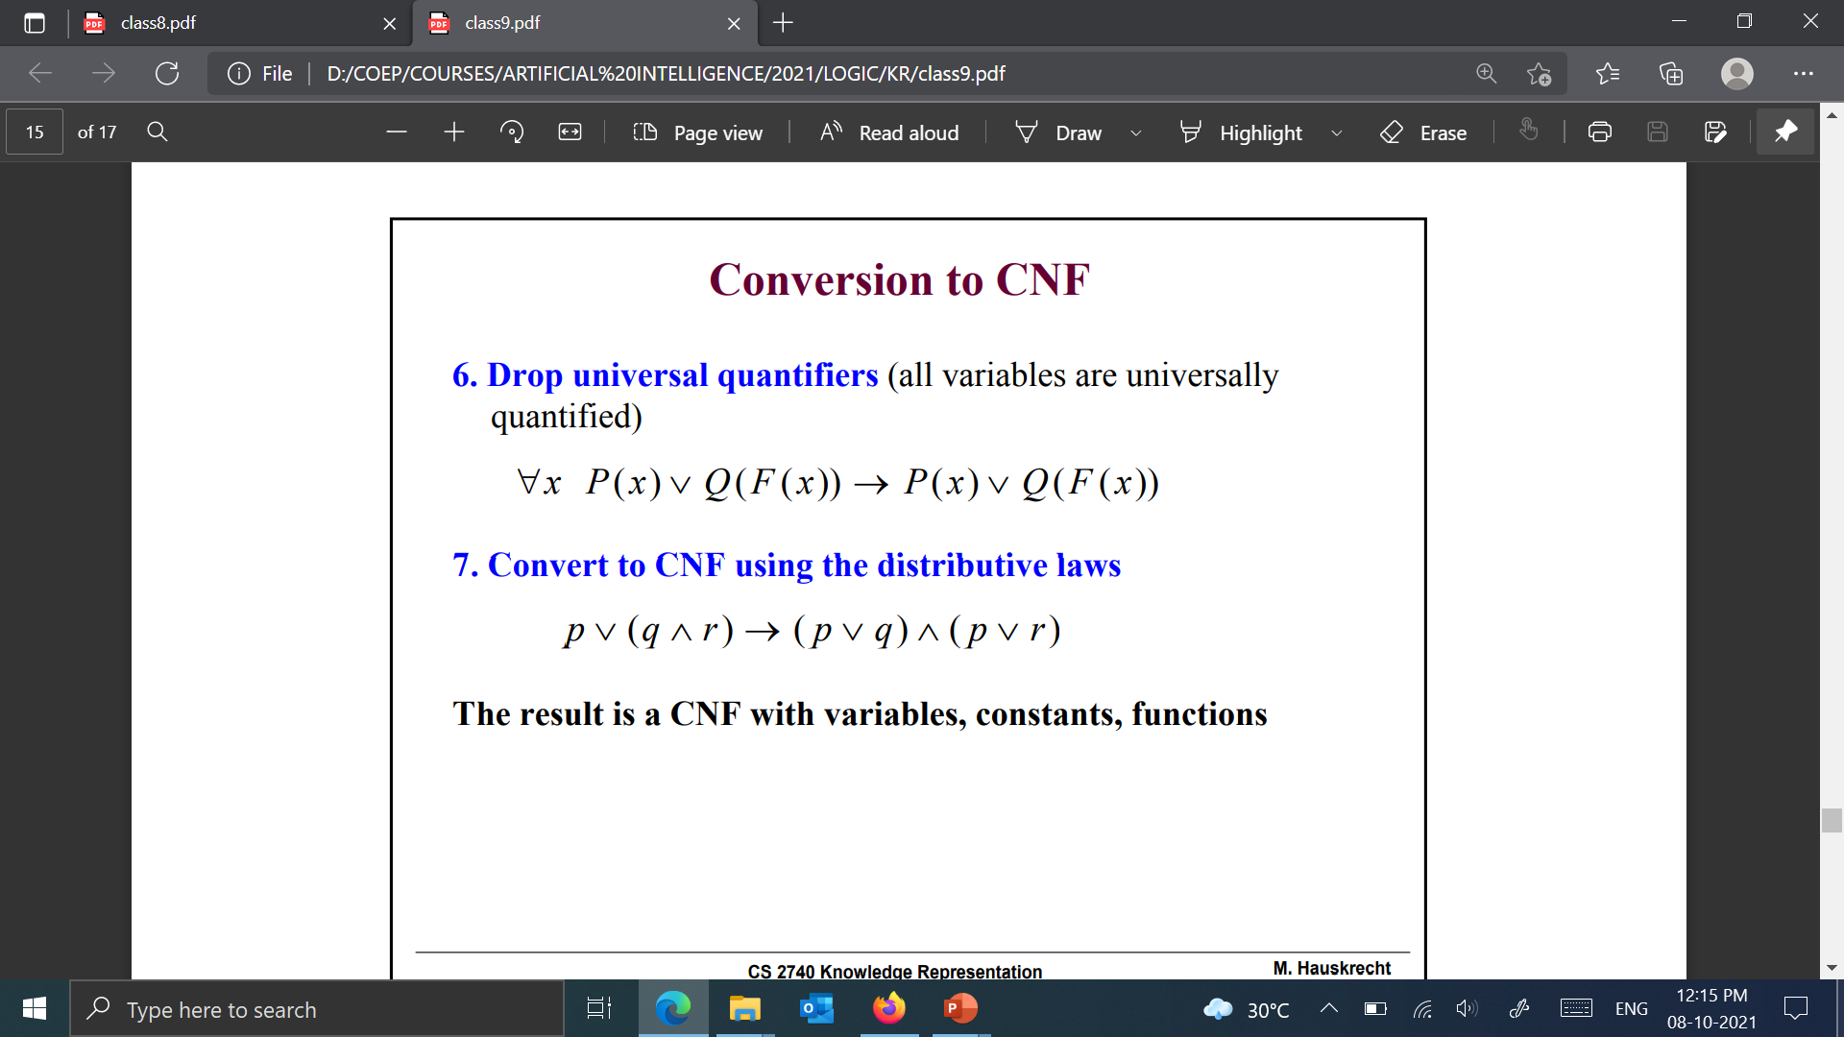
Conversion to CNF
Skolemization (removal of existential quantifiers through elimination)
If no universal quantifier occurs before the existential quantifier, replace the variable with a new constant symbol
If a universal quantifier precede the existential quantifier replace the variable with a function of the “universal” variable
F(x) - a Skolem function
Drop universal quantifiers (all variables are universally quantified)
Convert to CNF using the distributive laws

Slide 57
Conjunctive Normal Form - Revisited
Literal = possibly negated atomic sentence
e.g., ¬rich(x), or unhappy(bob), etc.
Clause = disjunction of literals
e.g., ¬rich(x) ∨ unhappy(x)
The KB is a conjunction of clauses
Any first-order logic KB can be converted into CNF:
1. Replace P ⇒ Q with ¬P ∨ Q
2. Move inward the negation symbol, e.g., ¬∀x P becomes ∃x ¬P
3. Standardize variables apart, e.g., ∀x P ∨ ∃x Q becomes ∀x P ∨ ∃y Q
4. Move quantifiers left in order, e.g., ∀x P ∨ ∃y Q becomes ∀x∃y (P ∨ Q)
5. Eliminate ∃ by Skolemization (see later slide)
6. Drop universal quantifiers (we’ll assume they are implicit)
7. Distribute ∧ over ∨ , e.g., ( P ∧ Q) ∨ R becomes (P ∨ Q) ∧ (P ∨ R)
8. Split conjunctions (into a set of clauses) and rename variables

Slide 58
Skolemization
The rules for Skolemization is essentially the same as those we described for quantifier inference rules
if ∃ does not occur within the scope of a ∀, then drop ∃, and replace all occurrence of the existentially quantified variable with a new constant symbol (called the Skolem constant)
e.g., ∃x P(x) becomes P(â), where â is a new constant symbol
if ∃ is within the scope of any ∀, then drop ∃, and replace the associated variable with a Skolem function (a new function symbol), whose arguments are the universally quantified variables
e.g., ∀x∀y∃z P(x, y, z) becomes ∀x∀y P(x, y, sk(x, y))
e.g., ∀x person(x) ⇒ ∃y heart(y) ∧ has(x,y)
becomes ∀x person(x) ⇒ heart(sk(x)) ∧ has(x, sk(x))

Slide 59
Conversion to CNF - Example
Convert:
(1)
(2)
(3)
(4)
(5)
(6)
(7)
(8)
Replace P ⇒ Q with ¬P ∨ Q
Move inward the negation symbol
Standardize variables apart
Move quantifiers left in order
Eliminate ∃ by Skolemization
Drop universal quantifiers
Distribute ∧ over ∨
Split conjunctions (into a set of clauses) and rename variables

Slide 60
Refutation Procedure - Example
KB =
KB ╞
KB ╞

Slide 61
Refutation Procedure - Example
KB =
Converting 4 to CNF:
Converting 5 to CNF:

Slide 62
Refutation Procedure - Example (cont.)
Here is the final KB in clausal form:
KB =
Next we want to prove the following using resolution refutation:
(there is someone who is john’s parent)

Slide 63
Refutation Procedure - Example (cont.)
Here is the final KB in clausal form:
KB =
A digression: what if we wanted to add a clause saying that there is someone
who is neither the father nor the mother of john:
In clausal form:
Next we want to prove each of the following using resolution refutation:
(sue is a grandparent of mary)
(there is someone who is john’s parent)

Slide 64
Refutation Procedure - Example (cont.)
To prove, we must first negate the goal and transform into clausal form:
The refutation (proof by contradiction):
(clause 4)
y = john
(clause 3)
x = bob
Note that the proof is constructive: we end up with an answer x = bob

Slide 65
Refutation Procedure - Example (cont.)
Here is the final KB in clausal form:
KB =
Next we want to prove the following using resolution refutation:
(sue is a grandparent of mary)

Slide 66
Refutation Procedure - Example (cont.)
Now, let’s prove that sue is the grandparent of mary:
(clause 6)
x = sue
y = mary
(clause 4)
z = x₁
y₁ = mary
(clause 1)
x₁ = john
(clause 5)
x₂ = sue
y₂ = john
(clause 2)

Slide 67
Substitutions and Unification
A substitution is a set of bindings of the form v = t, where v is a variable and t is a term
If P is an expression and σ is a substitution, then application of σ to P, denoted by (P)σ, is the result of simultaneously replacing each variable x in P with a term t, where x = t is in σ
E.g., P = likes(sue, z), and σ = {w = john, z = mother_of(john)}
then (P)σ = likes(sue, mother_of(john))
E.g., P = likes(father_of(w), z), and σ = {w = john, z = mother_of(x)}
then (P)σ = likes(father_of(john), mother_of(x))
E.g., P = likes(father_of(z), z), and σ = {z = mother_of(john)}
then (P)σ = likes(father_of(mother_of(john)), mother_of(john))
E.g., P = likes(w, z), and σ = {w = john, z = mother_of(w)}
then (P)σ = likes(john, mother_of(john))

Slide 68
Example
KB
Ravi likes all kind of food.
Apple and vegetable are food
Anything anyone eats and not killed is food.
Ajay eats peanuts and still alive
Rita eats everything that Ajay eats.
Prove
Ravi likes peanuts.

Slide 69
Example
Step 1 : Convert the statements in to Predicate Logic
KB
Ravi likes all kind of food.
Apple and vegetable are food
Anything anyone eats and not killed is food.
Ajay eats peanuts and still alive
Rita eats everything that Ajay eats.
Prove
Ravi likes peanuts.
∀x food(x) → likes (Ravi, x)
food (Apple) ∧ food (vegetable)
∀a ∀b eats (a, b) ∧ ¬killed (a) → food (b)
eats (Ajay, Peanuts) ∧ alive (Ajay)
∀c eats (Ajay, c) → eats (Rita, c)
∀d alive(d) → ¬killed (d)
∀e ~killed(e) → alive(e)
Prove: likes (Ravi, Peanuts)

Slide 70
Example
Step 2 : Convert the Predicate Logic Statement into CNF
KB
∀x food(x) → likes (Ravi, x)
food (Apple) ^ food (vegetable)
∀a ∀b eats (a, b) ^ ~killed (a) → food (b)
eats (Ajay, Peanuts) ^ alive (Ajay)
∀c eats (Ajay, c) → eats (Rita, c)
∀d alive(d) → ~killed (d)
∀e ~killed(e) → alive(e)
Prove
Ravi likes peanuts.
¬food(x) ∨ likes (Ravi, x)
food (Apple) ∧ food (vegetable)
¬eats (a, b) ∨ killed (a) ∨ food (b)
eats (Ajay, Peanuts) ∧ alive (Ajay)
¬eats (Ajay, c) V eats (Rita, c)
¬alive (d) ∨ ¬killed (d)
Killed (e) ∨ alive (e)
Prove: ¬likes (Ravi, Peanuts)

Slide 71
Resolution
¬likes(Ravi, Peanuts) ¬food(x) ∨ likes (Ravi, x)
¬food(Peanuts) ¬eats(a, b) ∨ killed(a) ∨ food(b)
¬eats (a, Peanuts) ∨ killed (a) eats (Ajay, Peanuts)
killed (Ajay) ¬alive (d) ∨ ¬killed (d)
¬alive (Ajay) alive (Ajay)
{ } proved
¬food(x) ∨ likes (Ravi, x)
food (Apple)
food (vegetable)
¬eats (a, b) ∨ killed (a) ∨ food (b)
eats (Ajay, Peanuts)
alive (Ajay)
¬eats (Ajay, c) V eats (Rita, c)
¬alive (d) ∨ ¬killed (d)
Killed (e) ∨ alive (e)
¬likes (Ravi, Peanuts)
x = Peanut
b = Peanut
a = Ajay
d = Ajay

Slide 72
Resolution
¬likes(Ravi, Peanuts) ¬food(x) ∨ likes (Ravi, x)
¬food(Peanuts) ¬eats(a, b) ∨ killed(a) ∨ food(b)
¬eats (a, Peanuts) ∨ killed (a) eats (Ajay, Peanuts)
killed (Ajay) ¬alive (d) ∨ ¬killed (d)
¬alive (Ajay) alive (Ajay)
{ }
x = Peanut
b = Peanut
a = Ajay
d = Ajay

Slide 73
KB in Restricted Forms
The sentences in the KB are restricted to some special forms
Horn form (Horn normal form)
(A ∨ ¬B) ∧ (¬ A ∨ ¬C ∨ D) Also be written as: (A ⇒ B) ∧ ( A ∧ C) ⇒ D)
A disjunction of literals with at most one positive, i.e. unnegated, literal.
A clause with one literal, e.g. A, is also called a fact
A clause representing an implication (with a conjunction of positive literals in antecedent and one positive literal in consequent), is also called a rule
Two inference rules that are sound and complete with respect to propositional symbols for KBs in the Horn normal form:
Resolution (positive unit resolution)
Modus ponens

Slide 74
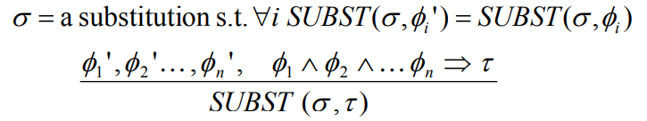
Horn normal form in FOL
First-order logic (FOL)
Adds variables, works with terms
Generalized modus ponens rule:
Generalized modus ponens:
Is sound and complete for definite clauses and no functions
In general it is semidecidable
Not all first-order logic sentences can be expressed in the HNF form

Slide 75
Entailment with Horn Clause
Deciding entailment with Horn clauses can be done in time that is linear in the size of the knowledge base
Forward Chaining:
Idea: Whenever the premises of a rule are satisfied, infer the conclusion. Continue with rules that became satisfied.
Typical usage: If we want to infer all sentences entailed by the existing KB.
Backward Chaining:
Idea: To prove the fact that appears in the conclusion of a rule prove the premises of the rule. Continue recursively
Typical usage: If we want to prove that the target (goal) sentence is α entailed by the existing KB.

Slide 76
Forward and Backward Chaining
Work forward from KB to query α:
Fire any rule whose premises are satisfied in the KB
Add its conclusion to the KB, until query α is found
Work backwards from the query α to KB:
Check if α is known already, or
Prove by BC all premises of some rule concluding α
Assume the KB with the following rules and facts
KB: R1: Steamboat (x) ∧ Sailboat (y) ⇒ Faster (x, y) α = Faster (Titanic , PondArrow ) R2: Sailboat (y) ∧ RowBoat (z) ⇒ Faster (y, z)
R3: Faster (x, y) ∧ Faster (y, z) ⇒ Faster (x, z)
F1: Steamboat (Titanic)
F2: Sailboat (Mistral)
F3: RowBoat(PondArrow)

Slide 77
Forward and Backward Chaining
Assume the KB with the following rules and facts
KB: R1: Steamboat (x) ∧ Sailboat(y) ⇒ Faster(x, y) α = Faster(Titanic, PondArrow) R2: Sailboat(y) ∧ RowBoat(z) ⇒ Faster(y, z)
R3: Faster(x, y) ∧ Faster(y, z) ⇒ Faster(x, z)
F1: Steamboat(Titanic)
F2: Sailboat(Mistral)
F3: RowBoat(PondArrow)

Slide 78
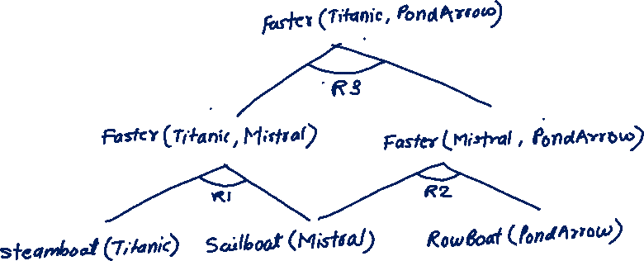
Forward and Backward Chaining
Assume the KB with the following rules and facts
KB: R1: Steamboat (x) ∧ Sailboat(y) ⇒ Faster(x, y) α = Faster(Titanic, PondArrow) R2: Sailboat(y) ∧ RowBoat(z) ⇒ Faster(y, z)
R3: Faster(x, y) ∧ Faster(y, z) ⇒ Faster(x, z)
F1: Steamboat(Titanic)
F2: Sailboat(Mistral)
F3: RowBoat(PondArrow)
Rule R1 is satisfied: x/Titanic, y/Mistral
F4: Faster(Titanic, Mistral)
Rule R2 is satisfied: y/Mistral, z/PondArrow
F5: Faster(Mistral, PondArrow)
Rule R3 is satisfied:
Faster(Titanic, PondArrow)

Slide 79
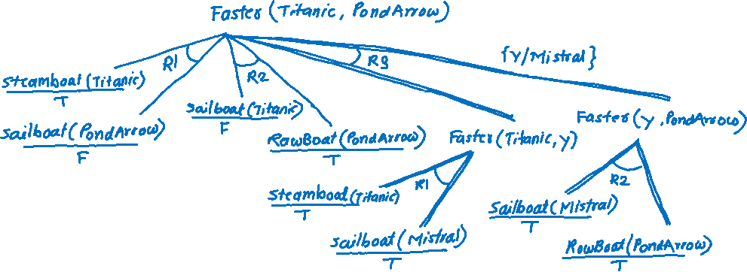
Forward and Backward Chaining
Assume the KB with the following rules and facts
KB: R1: Steamboat (x) ∧ Sailboat ( y) ⇒ Faster (x, y) α = Faster (Titanic , PondArrow ) R2: Sailboat ( y) ∧ RowBoat (z) ⇒ Faster ( y, z)
R3: Faster (x, y) ∧ Faster ( y, z) ⇒ Faster (x, z)
F1: Steamboat (Titanic )
F2: Sailboat (Mistral )
F3: RowBoat(PondArrow)

Slide 80
Example
Encode the following English statement into First-Order definite cluses.
"The law says that it is a crime for an American to sell weapons to hostile nations. The country Nano, an enemy of America, has some missiles, and all of its missiles were sold to it by Colonel West, who is American."
Prove the following by using the forward and backward chaining
“Colonel West is a criminal”

Slide 81
Terms
"The law says that it is a crime for an American to sell weapons to hostile nations. The country Nano, an enemy of America, has some missiles, and all of its missiles were sold to it by Colonel West, who is American."
Constants:
America
Nano
West
Function (propoerty):
American(x): x is an American
Weapon(x): x is a weapon
Hostile(x): x is a hostile nation
Criminal(x): x is a criminal
Missile(x): x is a missile
Relation:
Owns(x, y): x owns y
Sells(x, y, z): x sells y to z
Enemy(x, y): x is an enemy of y

Slide 82
Example
Sentences
It is a crime for an American to sell weapons to hostile nations
Nano ... has some missiles
All of its missiles were sold to it by Colonel West
Missiles are weapons
An enemy of America counts as "hostile“
West, who is American
The country Nano, an enemy of America
First-Order Definite Clauses
Sells(x, y, z) ∧ American(x) ∧ Weapon(y) ∧ Hostile(z) ⇒ Criminal(x)
∃x Owns(Nano, x) ∧ Missile(x):
Owns(Nono,M1) ∧ Missile(M1)
Missile(x) ∧ Owns(Nano, x) ⇒ Sells(West, x, Nano)
Missile(x) ⇒ Weapon(x)
Enemy(x, America) ⇒ Hostile(x)
American(West)
Enemy(Nano, America)

Slide 83
Example
First-Order Definite Clauses
It is a crime for an American to sell weapons to hostile nations: American(x) ∧ Weapon(y) ∧ Sells(x, y, z) ∧ Hostile(z) ⇒ Criminal(x)
Nano ... has some missiles, i.e., ∃x Owns(Nano, x) ∧ Missile(x): Owns(Nono,M1) and Missile(M1)
All of its missiles were sold to it by Colonel West: Missile(x) ∧ Owns(Nano, x) ⇒ Sells(West, x, Nano)
Missiles are weapons: Missile(x) ⇒ Weapon(x)
An enemy of America counts as "hostile“: Enemy(x, America) ⇒ Hostile(x)
West, who is American: American(West)
The country Nano, an enemy of America: Enemy(Nano, America)

Slide 84
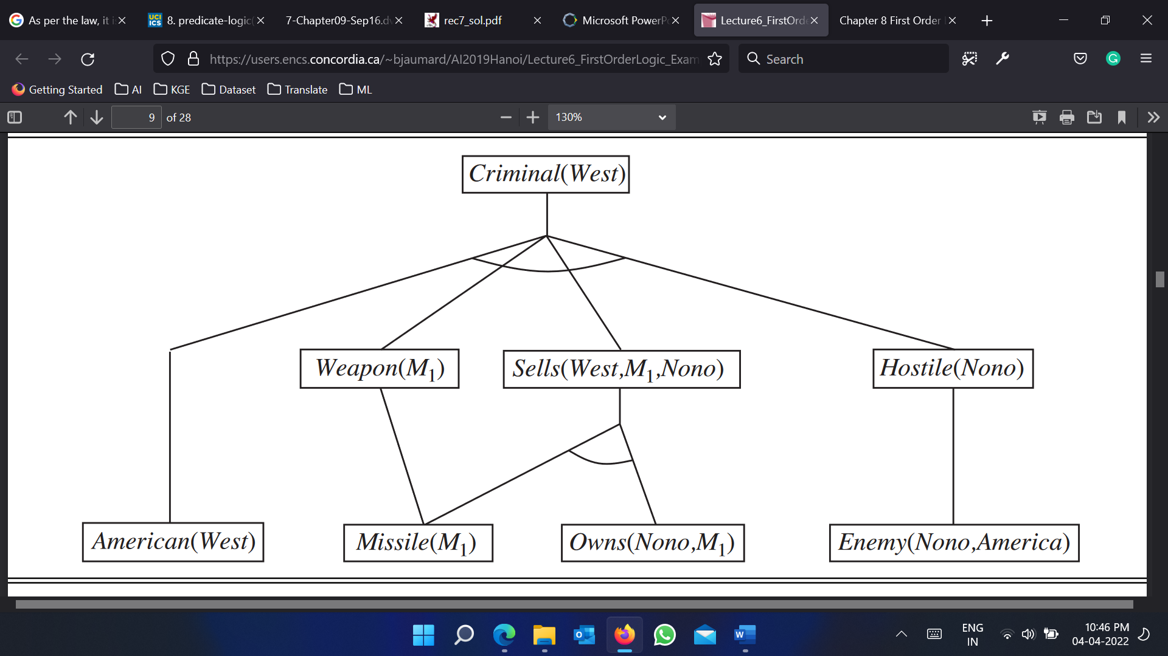
Forward Chaining
First-Order Definite Clauses
American(x) ∧ Weapon(y) ∧ Sells(x, y, z) ∧ Hostile(z) ⇒ Criminal(x)
Missile(x) ⇒ Weapon(x)
Enemy(x, America) ⇒ Hostile(x)
Missile(x) ∧ Owns(Nano, x) ⇒ Sells(West, x, Nano)
Owns(Nono,M1)
Missile(M1)
American(West)
Enemy(Nano, America)

Slide 85
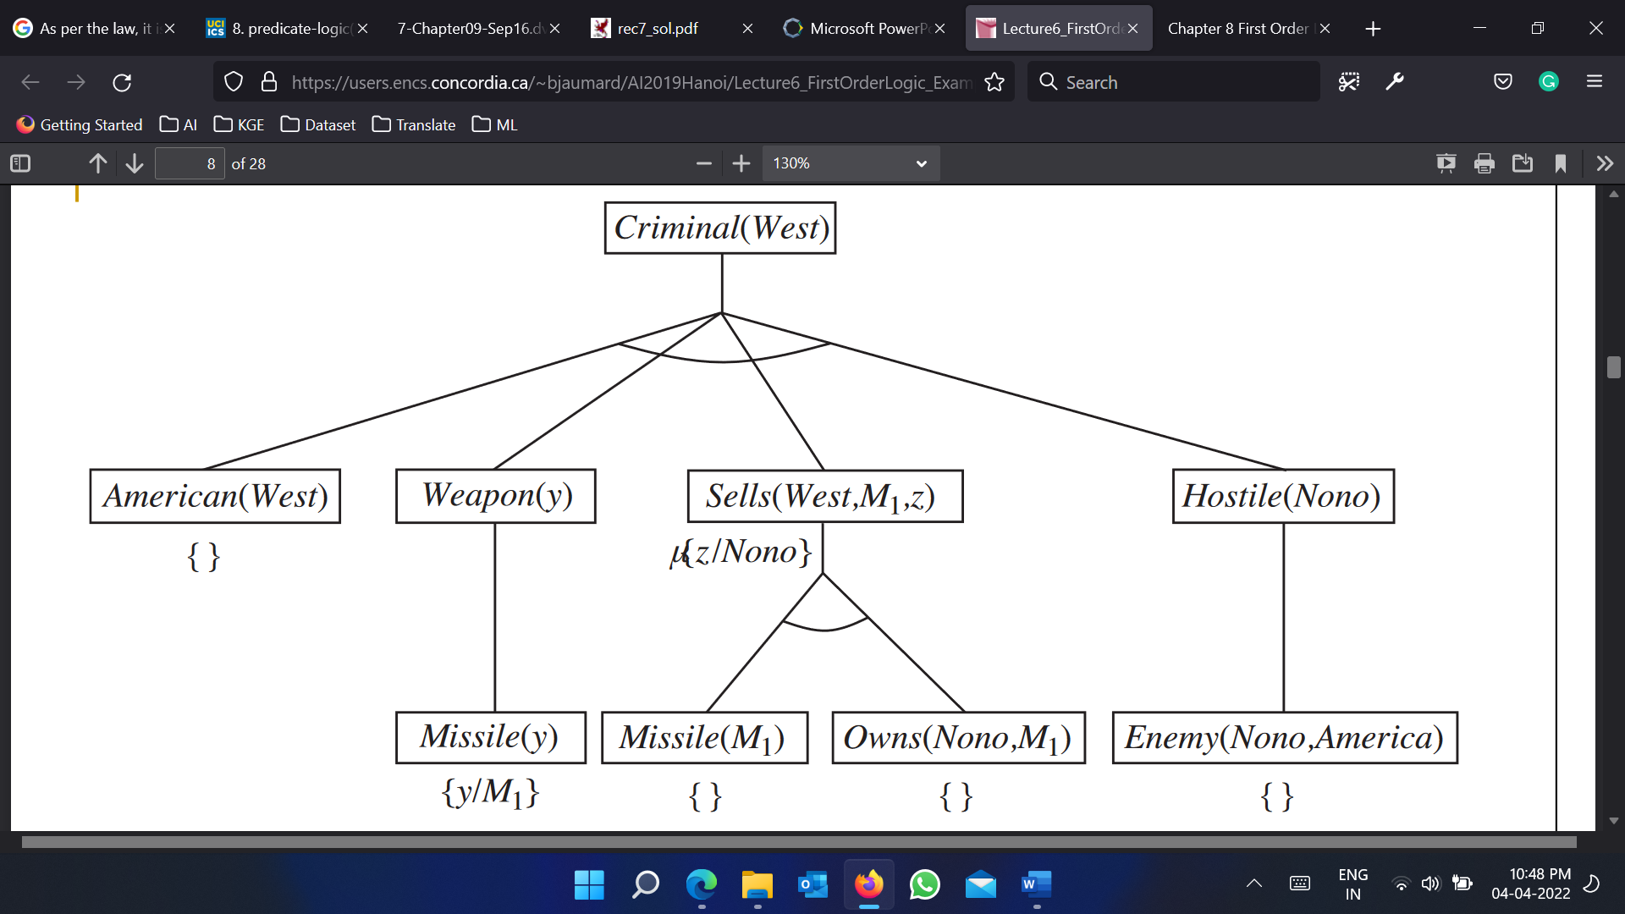
Backward Chaining
First-Order Definite Clauses
American(x) ∧ Weapon(y) ∧ Sells(x, y, z) ∧ Hostile(z) ⇒ Criminal(x)
Missile(x) ⇒ Weapon(x)
Enemy(x, America) ⇒ Hostile(x)
Missile(x) ∧ Owns(Nano, x) ⇒ Sells(West, x, Nano)
Owns(Nono,M1)
Missile(M1)
American(West)
Enemy(Nano, America)

Slide 86
Forward Chaining

Slide 87
Backward Chaining

Slide 88
Summary
First-order logic:
objects and relations are semantic primitives
syntax: constants, functions, predicates, equality, quantifiers
Increased expressive power: sufficient to express real-world problems
Resolution is complete for propositional logic Forward, backward chaining are linear-time, complete for Horn clauses
Problems:
Handling human conceptual categories, uncertainty and dynamics
Next week: Planning with FOL

